Slide 1
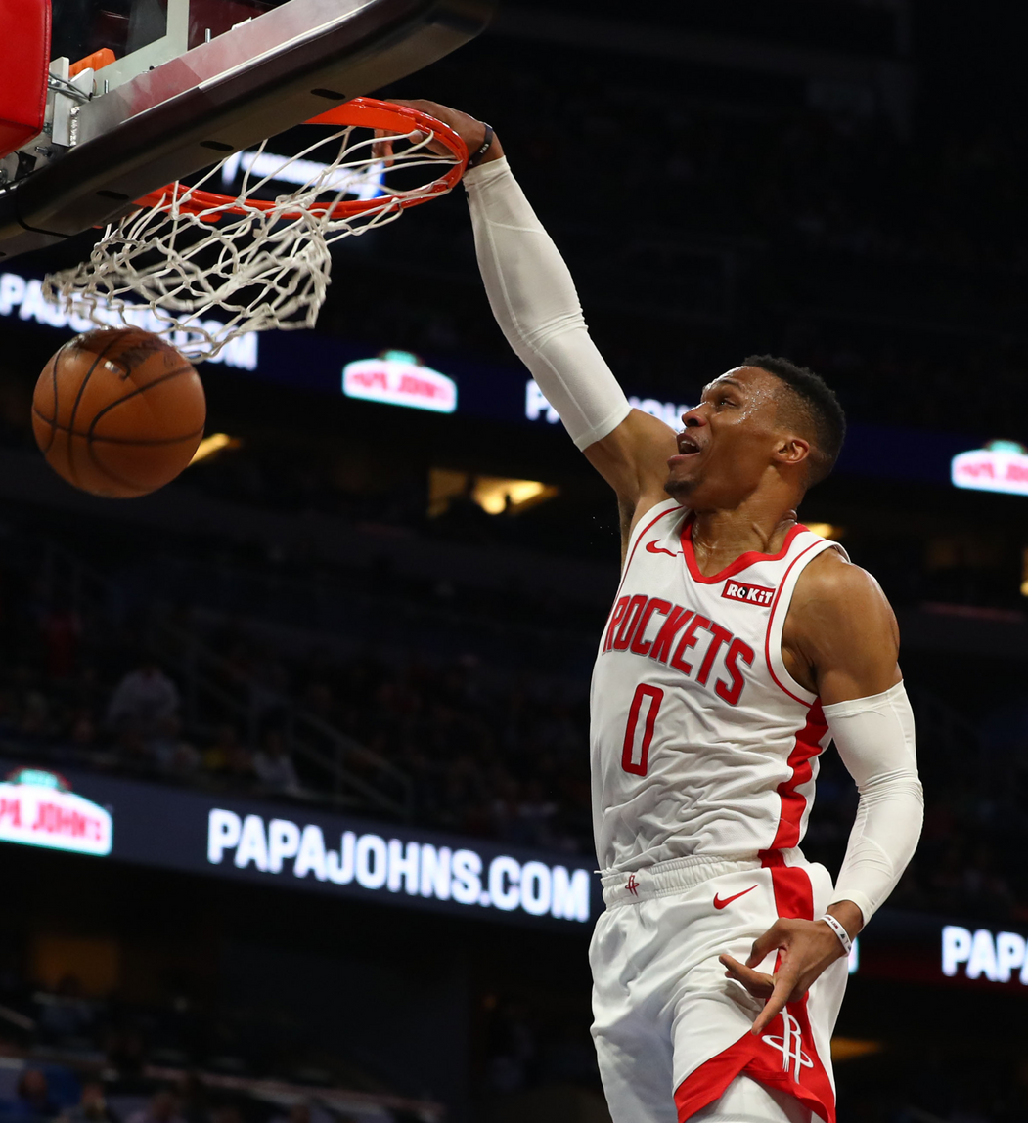
Be a Better Bettor
Never Bet Again, LLC

Slide 2
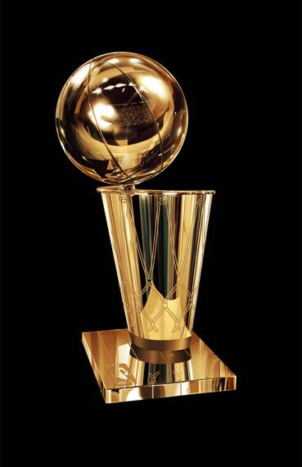
Gameplan
Keys to the Game
First Quarter: Approach
Second Quarter: Data Preparation
Third Quarter: Model Insights
Fourth Quarter: Real-Time Test
Overtime: Game-Changing Ideas

Slide 3
Problem Statement
Can I predict the outcome of an NBA game for betting purposes?

Slide 4
Terminology
Money Line: Will Team A beat Team B?
Spread: Will Team A beat Team B by X number of points
If yes, Team A "covered the spread"
If no, Team B "covered the spread"

Slide 5
Approach

Slide 6
Strategy
STEP 1
STEP 2
STEP 3
Use halftime data in order to predict spread of entire game
Collect and clean data available during halftime
Train and test models

Slide 7
Advantages
Can use readily available data
Less variance since half the game is played
Takes into account how "hot" a team is playing
Includes point differential

Slide 8
Data Preparation

Slide 9
Data Acquisition
Scraped data from official NBA website
Collected stats from first half and entire game
Saved information into csv file

Slide 10
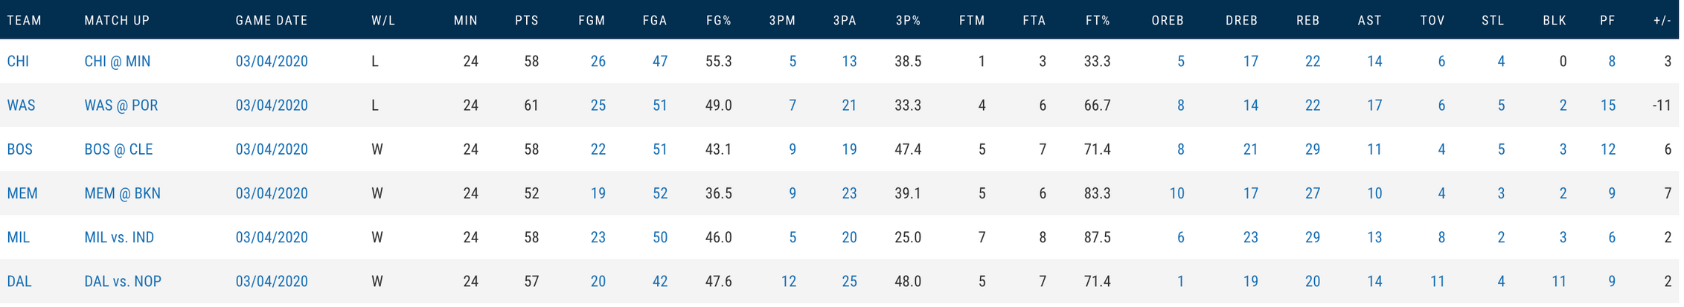
Data Acquisition

Slide 11
Data Manipulation
Converted teams to numerical values
Used plus/minus from entire game to set targets
Target columns indicated whether or not a team won specific number of points
Trained models on targets and tested them

Slide 12
Model Insights

Slide 13
Money Line
3 Point Win
5 Point Win
117
47
171
24
188
35
TN
FP
48
130
52
95
54
65
FN
TP
7 Point Win
214
14
247
9
10 Point Win
Rows = What actually happened
Cols = What model predicted
75
39
70
16

Slide 14
Spread Accuracy
Spread F1 Score
Money Line
3 Point Spread
5 Point Spread
7 Point Spread
10 Point Spread
71.2%72.9%
73.0%
75.4%
81.3%
Money Line
3 Point Spread
5 Point Spread
7 Point Spread
10 Point Spread
71.2%58.0%
48.9%
44.8%
40.7%

Slide 15
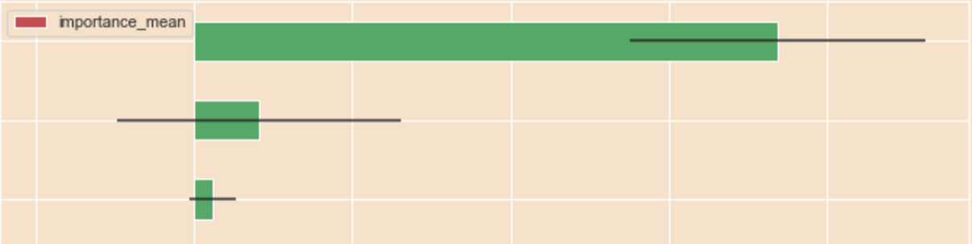
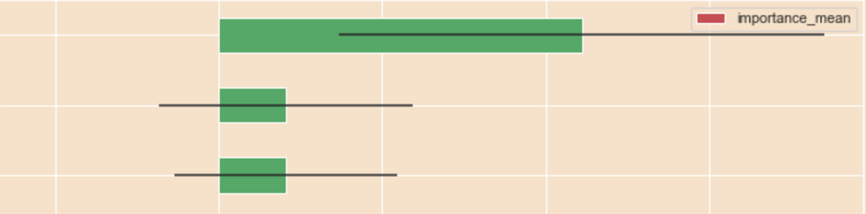
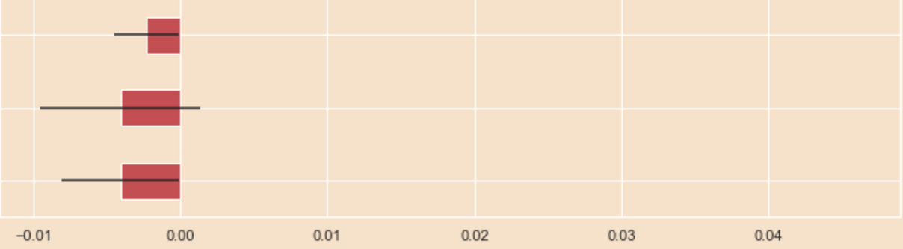
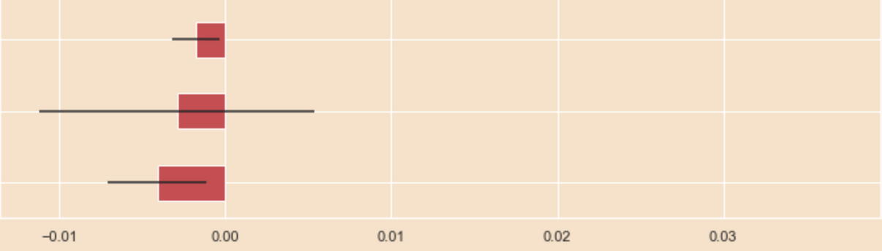
Money Line Features
5 Point Win Features
+/-
+/-
BLK
PF
3P%
STL
FT%
FGM
STL
BLK
PF
FG%
Each model finds different features important

Slide 16
Real-Time Test

Slide 17
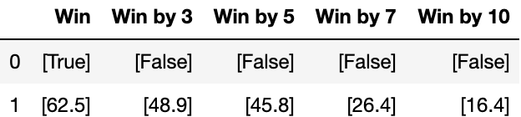
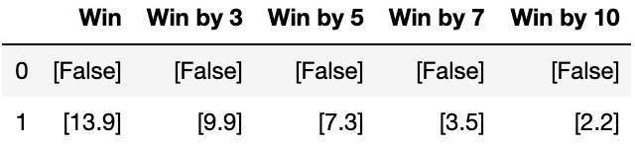
Knicks
Rockets
(18-42)
(39-20)
73
63

Slide 19
Incorporating the REF Plan

Slide 20
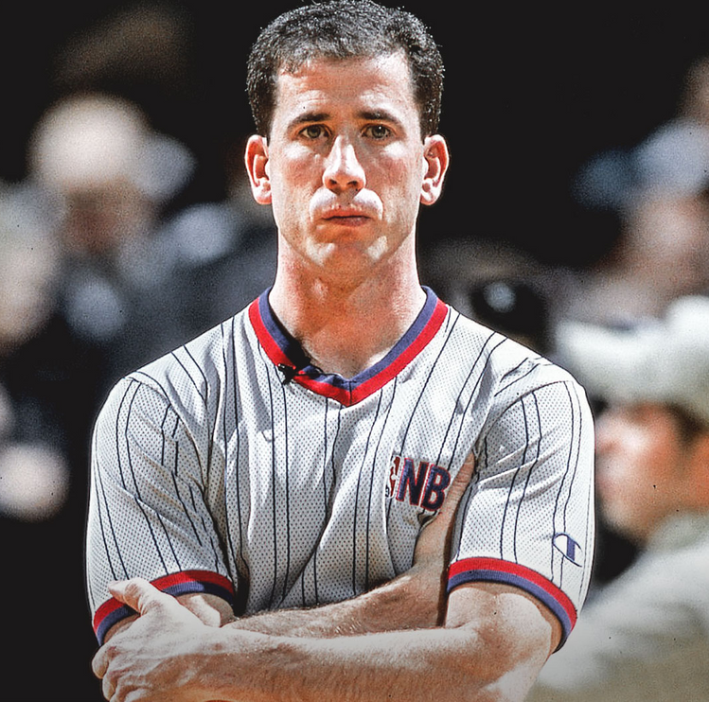
Game-Changing Employees
RECENCY
Weighting recent games higher
EXPERIENCE
Focused on hiring more experienced professionals to further ensure success
FEATURES
Adding more features like opponents stats, spread lines, etc
Betting Legend: Tim Donaghy

Slide 21



Questions?
Mayank Phanse
LinkedIn

